Slide 1
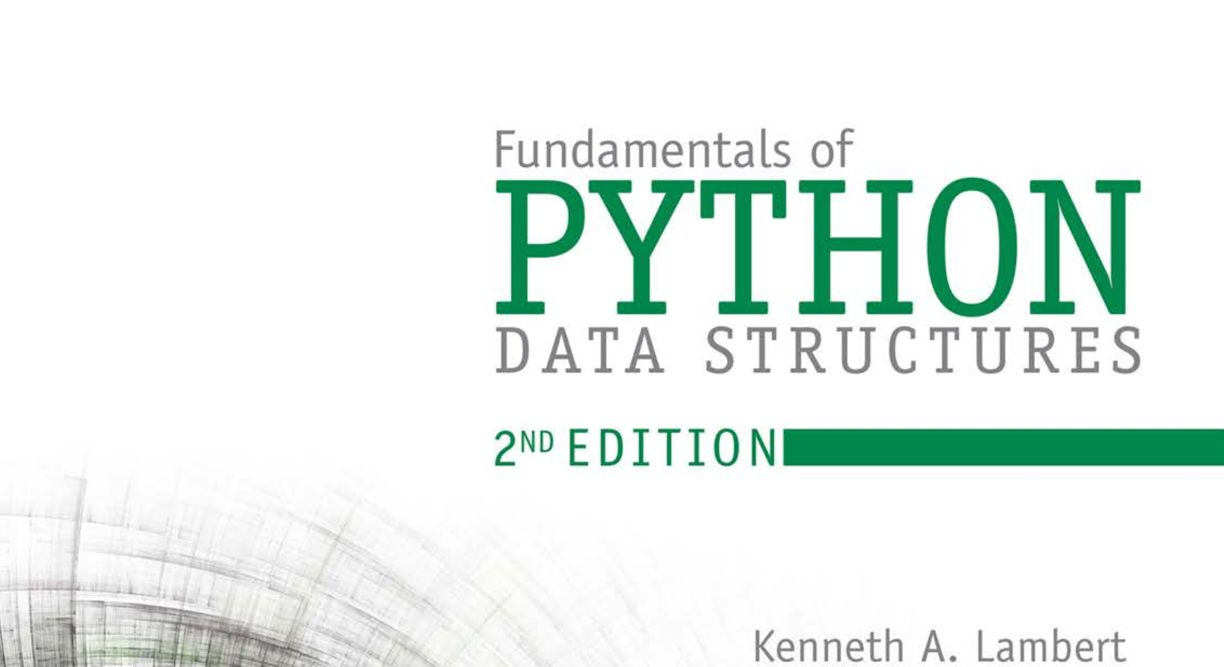
Database Systems: Design, Implementation, and Management 14th Edition
Chapter 1
Database Systems

Slide 2

National Economics University Faculty of Mathematical Economics
EP03.TITH1121 - DATA STRUCTURES AND ALGORITHMS: Searching and Sorting
Instructor: Duc Minh Vu (MFE)
Email: minhvd [at] neu.edu.vn
3/20/2024
Data Structures and Algorithms in Python
2

Slide 3
Learning Objectives
Describe the features of a tree
Describe various types of tree traversals
Recognize three common applications where it is appropriate to use a tree
Describe the features of a binary search tree and the operations on it
Recognize the three common applications where it is appropriate to use a binary search tree
Describe the features of an expression tree and the operations on it

